Slide 1
Capstone Project (Graduation Transitions)
Preparing for your Presentation

Slide 2

Capstone Presentations
Oh the PLACES you’ll go!
Graduating Class of 2024

Slide 3
Capstone Requirements
Community Connections
    30 hours of volunteer or work experience
Career and Life
    Capstone Project
    Presentation

Slide 4
Grad Transition Plan
You have 2 options:
Plan for Post Secondary Education or Other Training
    College, University, Trades Training, Training Institutes, etc.
Plan for Work or Other Life Options
    Entry Level Jobs, Travel, Family, Mission, etc.

Slide 5
GT Plan Components
Grad Transition questions and budget included in package
Current Resume
Reference Letter
Post-Secondary application, bursary/scholarship application, OR a cover letter (PS Option)
Cover Letter (Work or Other Life Options)

Slide 6
Presentation
Put together a presentation showcasing significant accomplishments and indicate how those learning experiences prepare you for successful transitions to life after secondary school.
Past, Present, and Future of YOU!

Slide 7
Outline
Introduction: Who am I? (1 min.)
Present evidence and discuss your skills: What have I accomplished?
(6-8 mins.)
Conclusion: Where am I going?
(6 mins.)

Slide 8
Introduction
Who am I?
Introduce yourself to the panel (shake hands and make eye contact).
Talk about your personal interests and goals.
Tell the panel what you are going to talk about (your 3 areas/evidence).

Slide 9
Select THREE areas of Accomplishment
Select 3 areas of accomplishment that have helped to shape who you are today
    Academic awards, school projects, CTC, work experience, sports accomplishments, volunteer, involvement in organizations, essays, over coming adversity, Fine Arts work, travel, wood working, etc.
Are you comfortable showing the evidence?
Choose a presentation format.
  Practice using format and answering questions.

Slide 10
Present evidence and discuss your skills:
What have I accomplished?
For EACH area/evidence:
Introduce the evidence.
Why did you choose this evidence?
How does the evidence show who you are as an individual?
What have you learned from this experience?
What skills have you gained?
Why will these skills be important to your future?
How does this link to the Attributes of an Educated Citizen? (Refer to handout.)

Slide 11
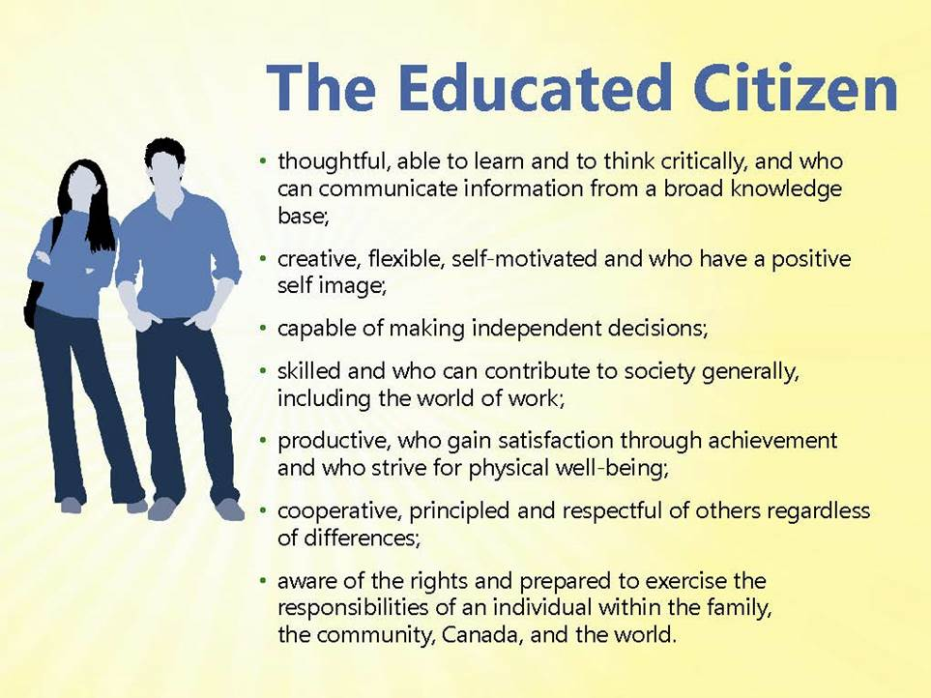
Attributes of an Educated Citizen

Slide 12
Conclusion:
Where am I going?
How have you matured/ learned/ developed and changed since grade 10?
What are your strengths?
What are areas you need to continue to develop and how might you develop these areas?
What are your education and/or career plans? – refer to your GT plan.
How are you going to achieve these goals?

Slide 13
Due Date
Capstone (Graduation Transition) Presentations:
March 12 & 13
ALL Students are required to complete ALL components of GTP.
This is a MANDATORY COURSE

Slide 14
Tech Info
If you use powerpoint please bring your presentation on a USB stick.
If you plan on bringing your own laptop and doing it on there make sure it is HDMI compatible.
If you have a Mac please bring your own adaptor as we do not support Apple products.

Slide 15
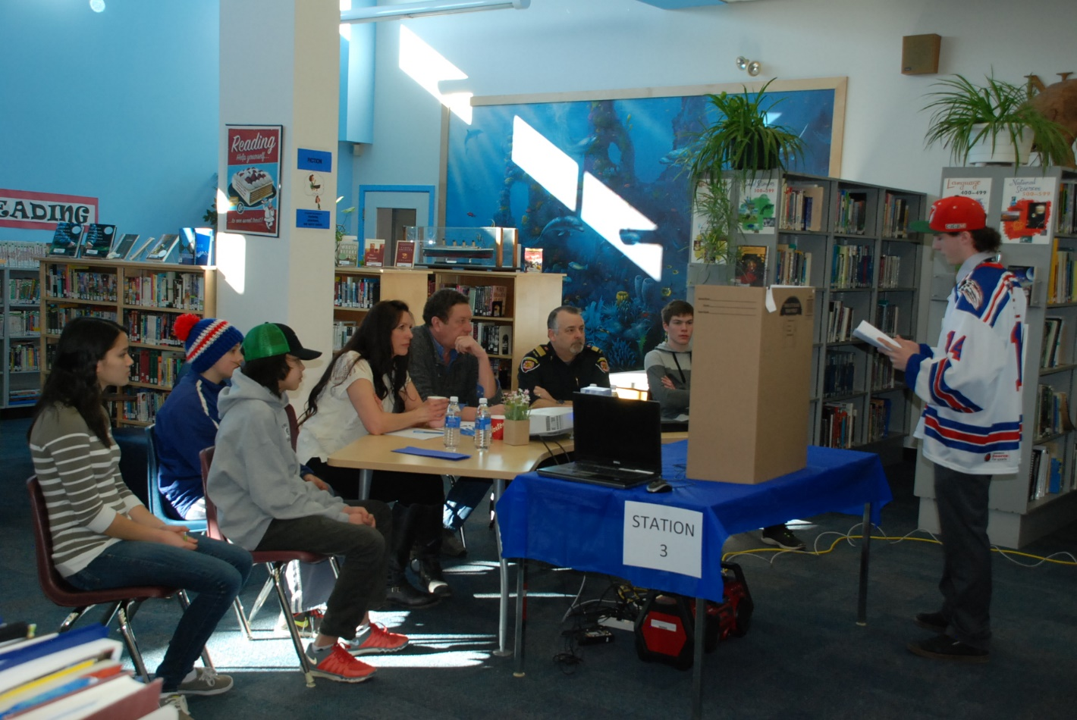
THIS IS WHAT IT LOOKS LIKE

Slide 16
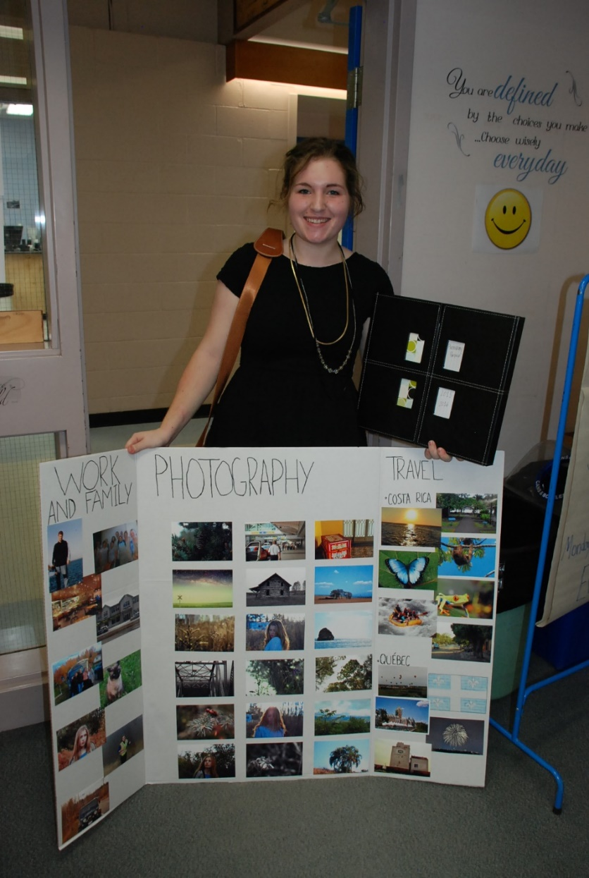
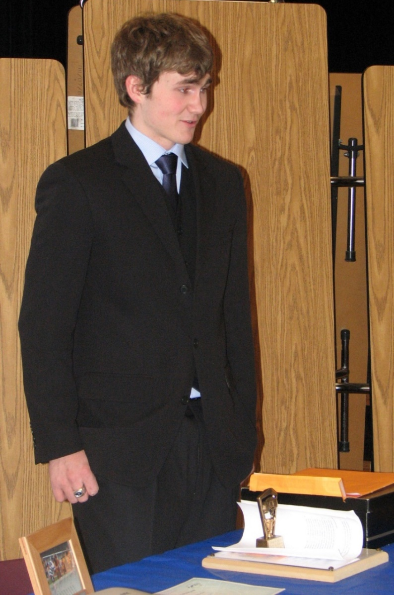
DRESS for the occasion!

Slide 17
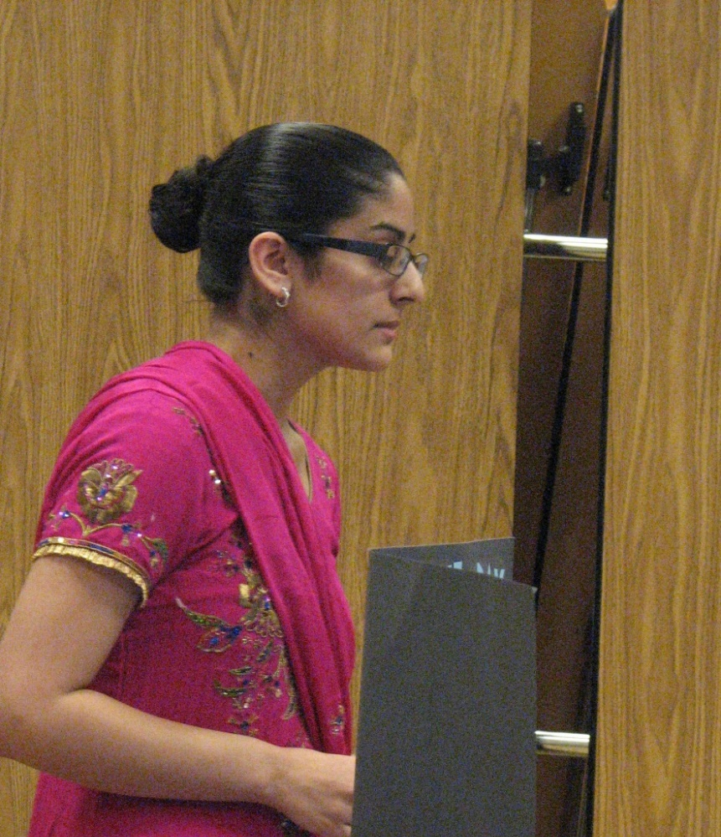
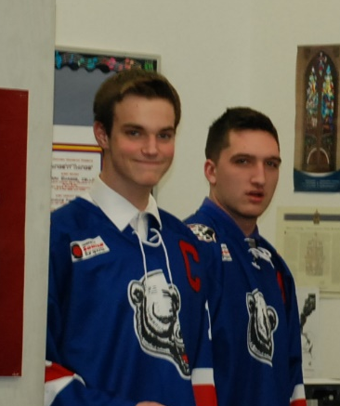
Create Interest and a good first impression!
Cultural Background
Uniform from work
Sports jersey
Costume

Slide 18
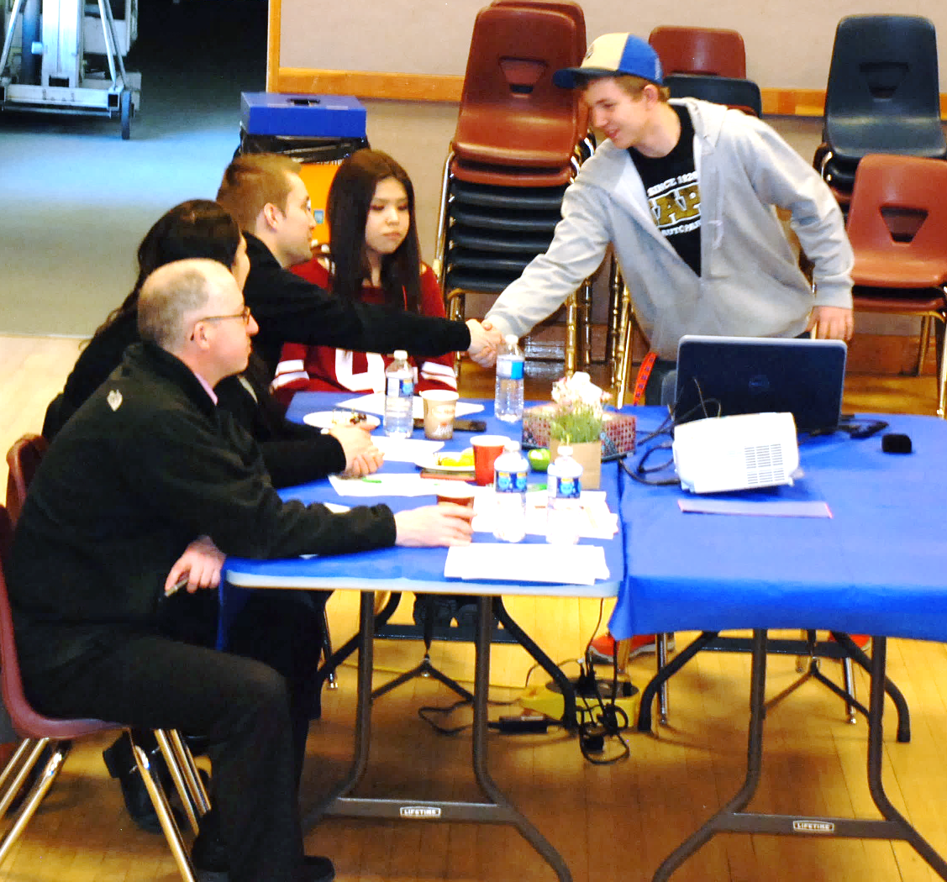
Begin by introducing yourself, shake hands, and SMILE! ☺

Slide 19
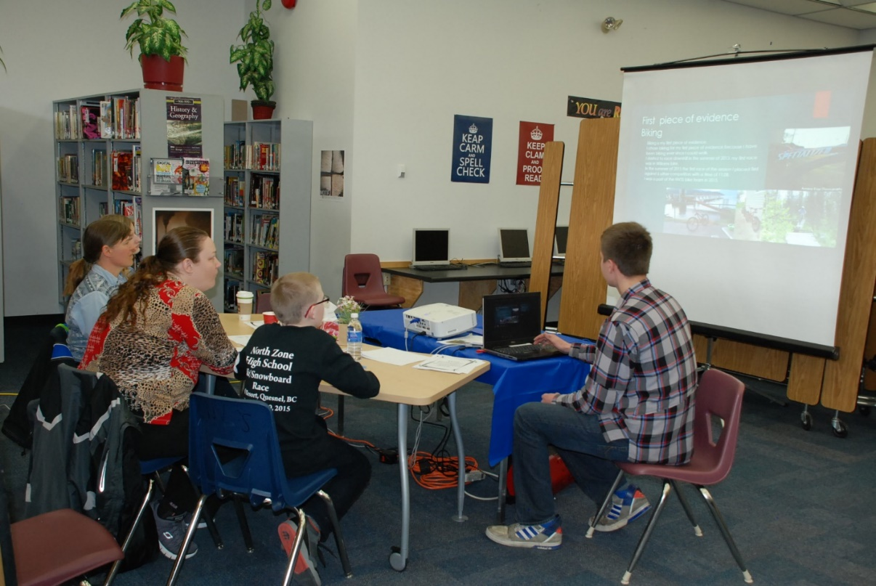
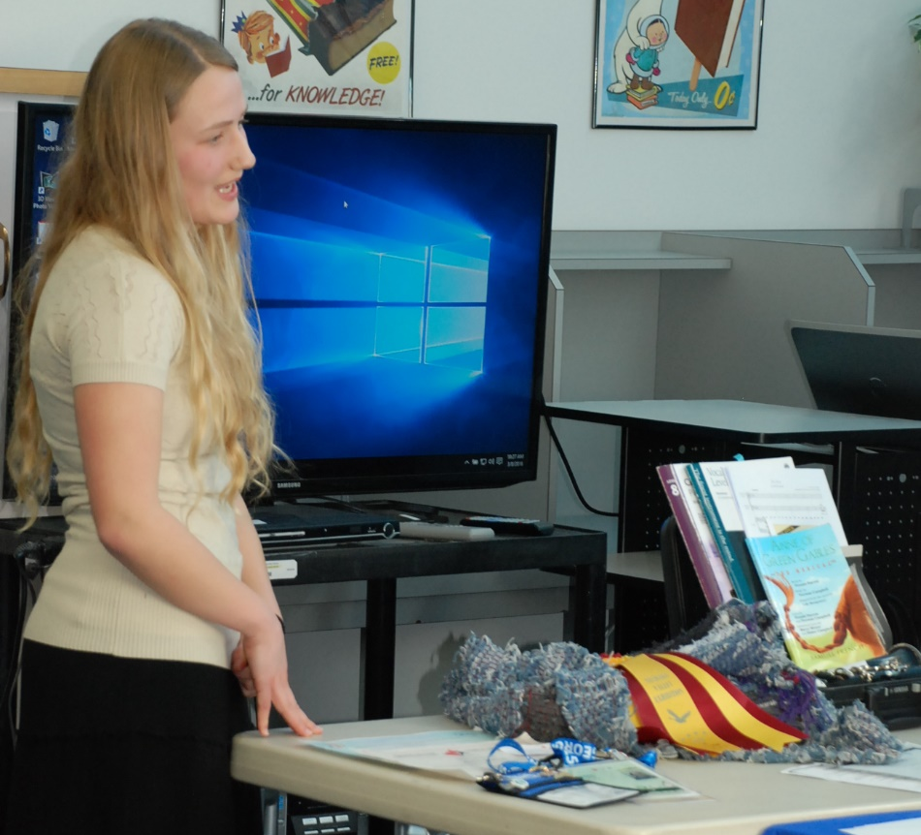
Be sure to have
THREE pieces of evidence

Slide 20
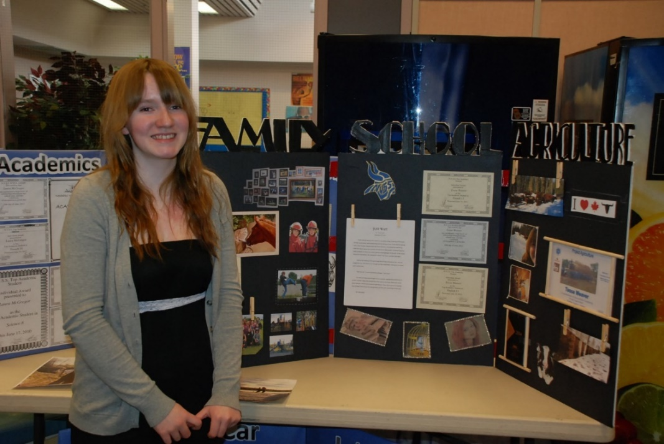
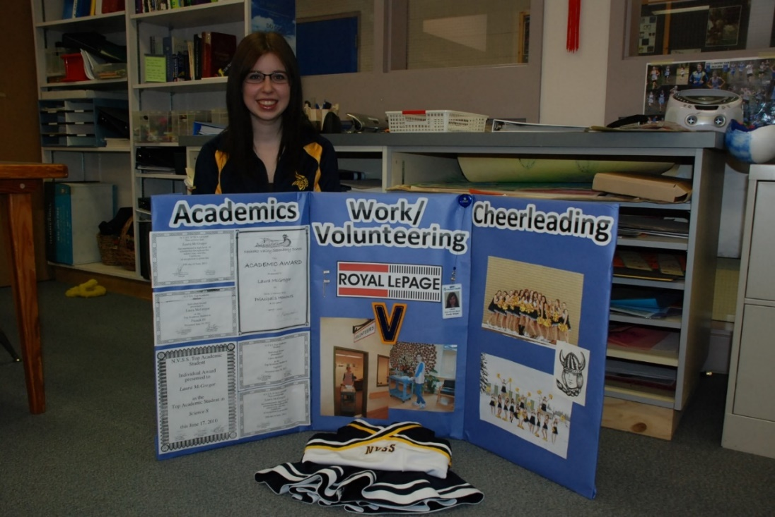
Use display boards to
showcase evidence

Slide 21
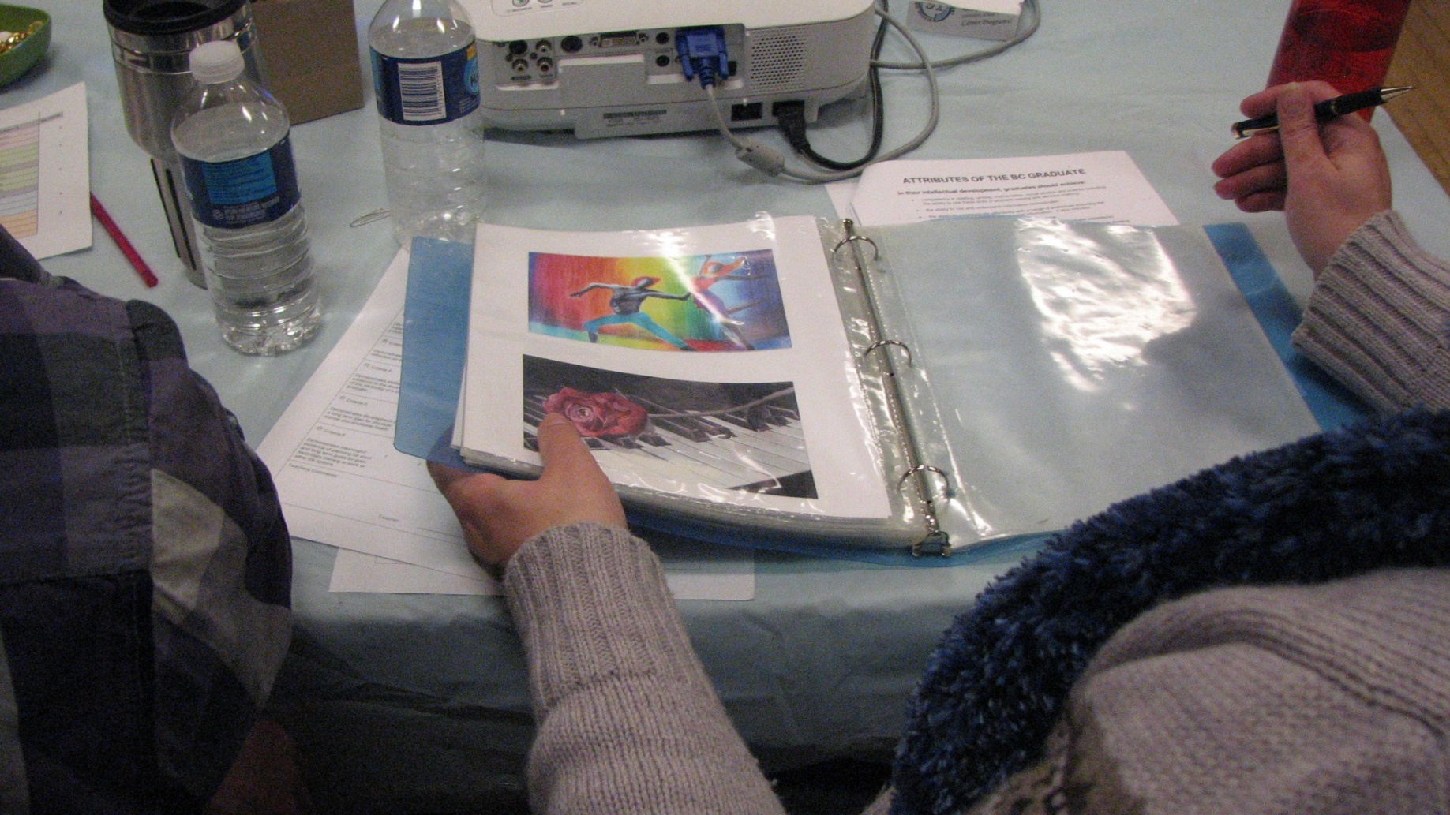
Or use a Portfolio

Slide 22
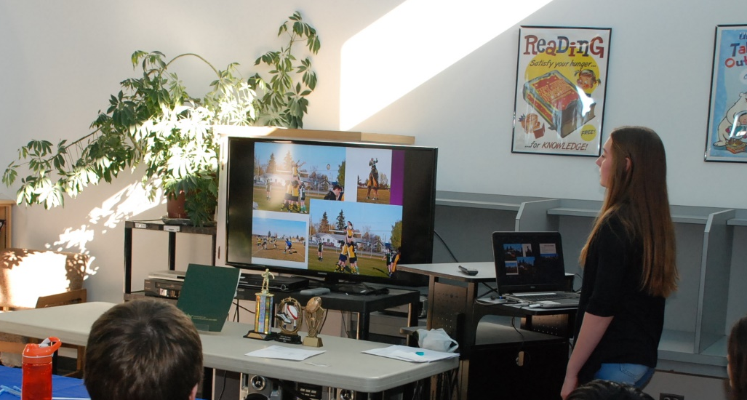
Or a Powerpoint Presentation

Slide 23
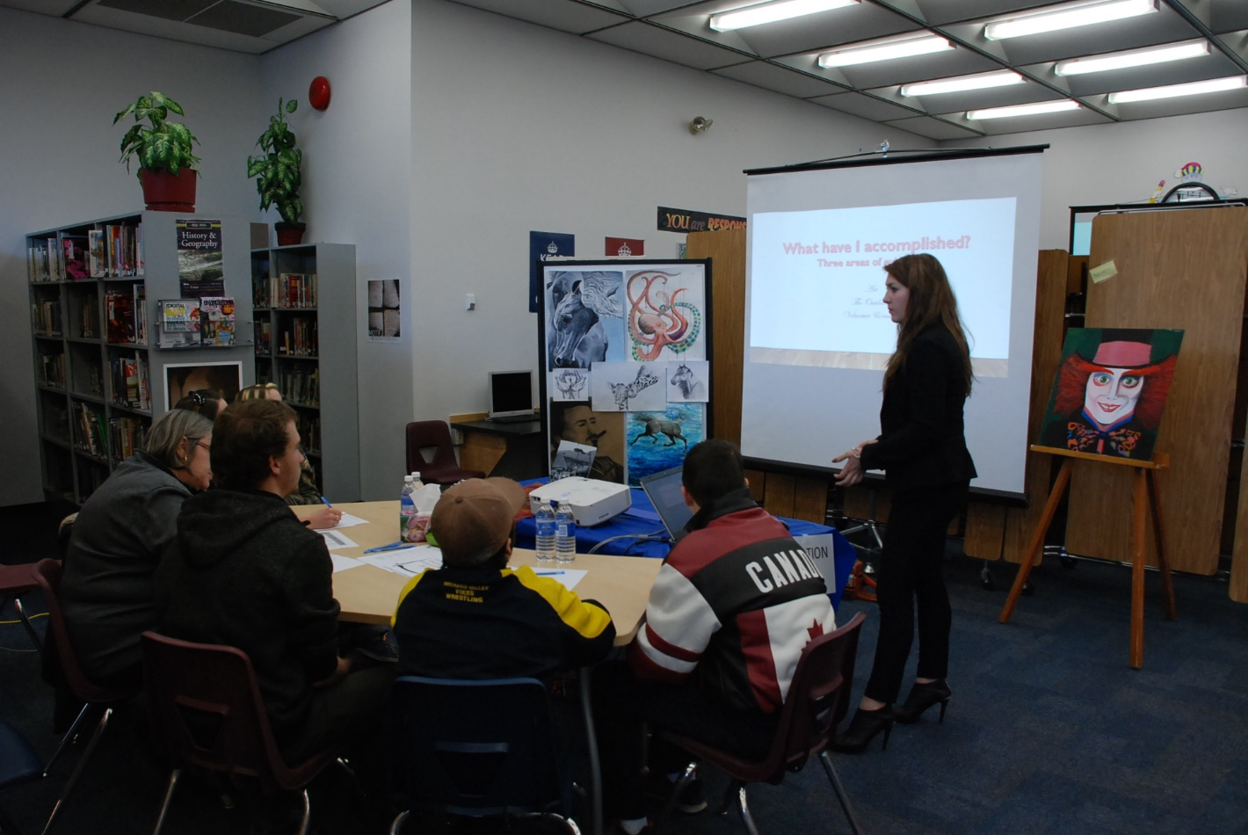
What Have I Accomplished?
What have I learned?
How have I changed since grade 10?

Slide 24
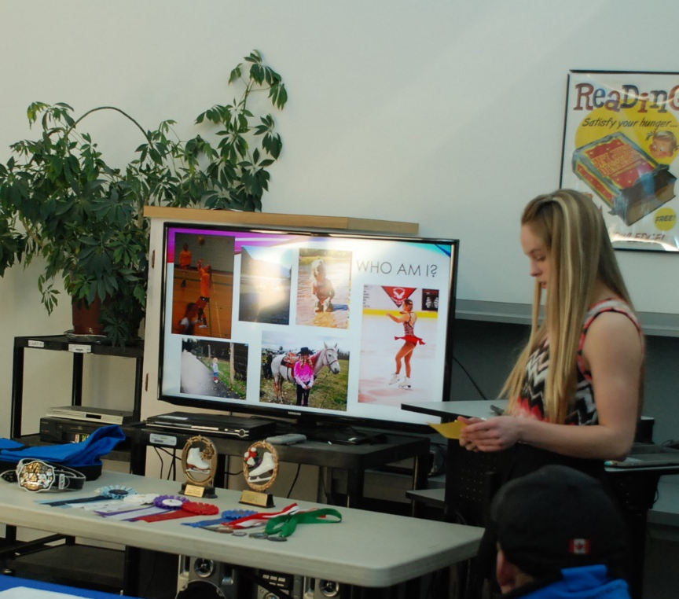
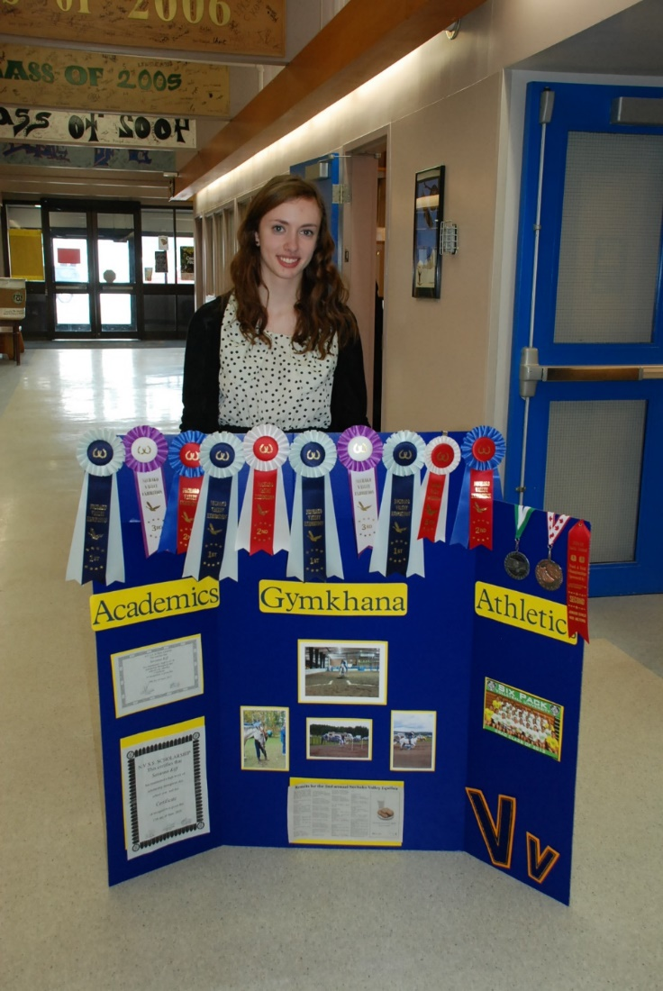
Celebrate yourself!
Achievements
Awards
Skills
Certificates
Medals Earned

Slide 25
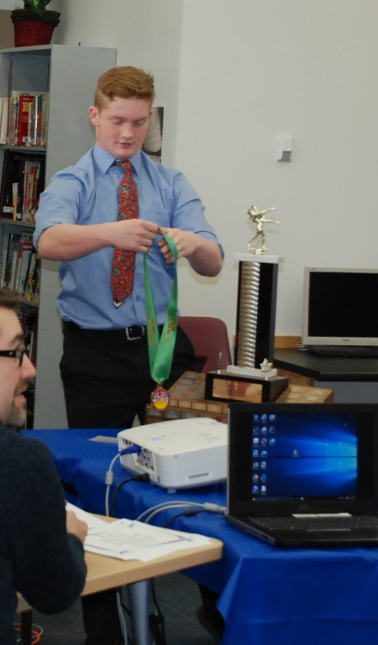
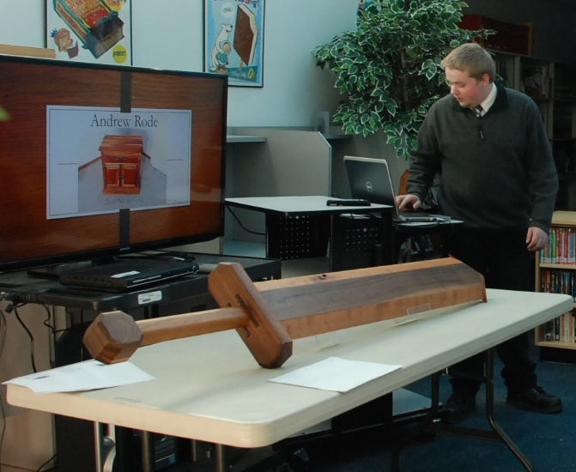
Woodworking Skills
Athletic Achievement

Slide 26
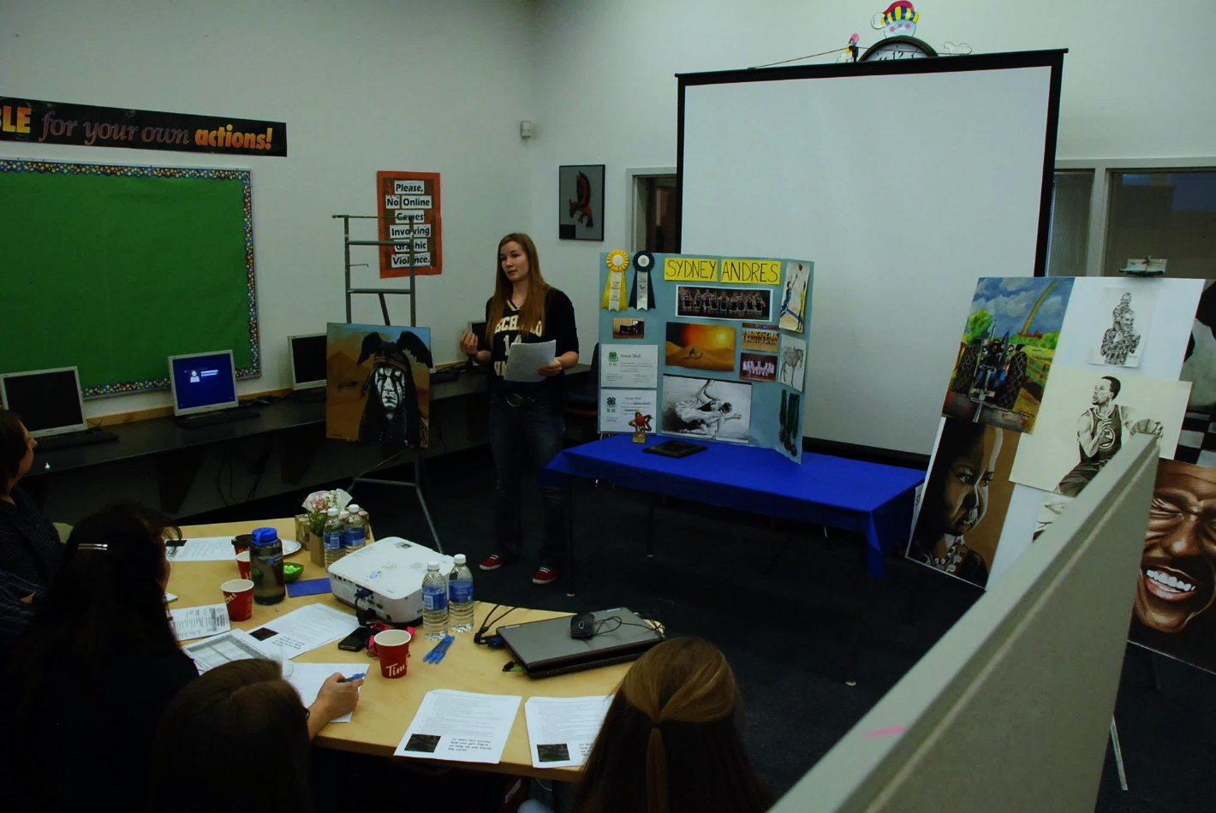
Artistic Accomplishments

Slide 27
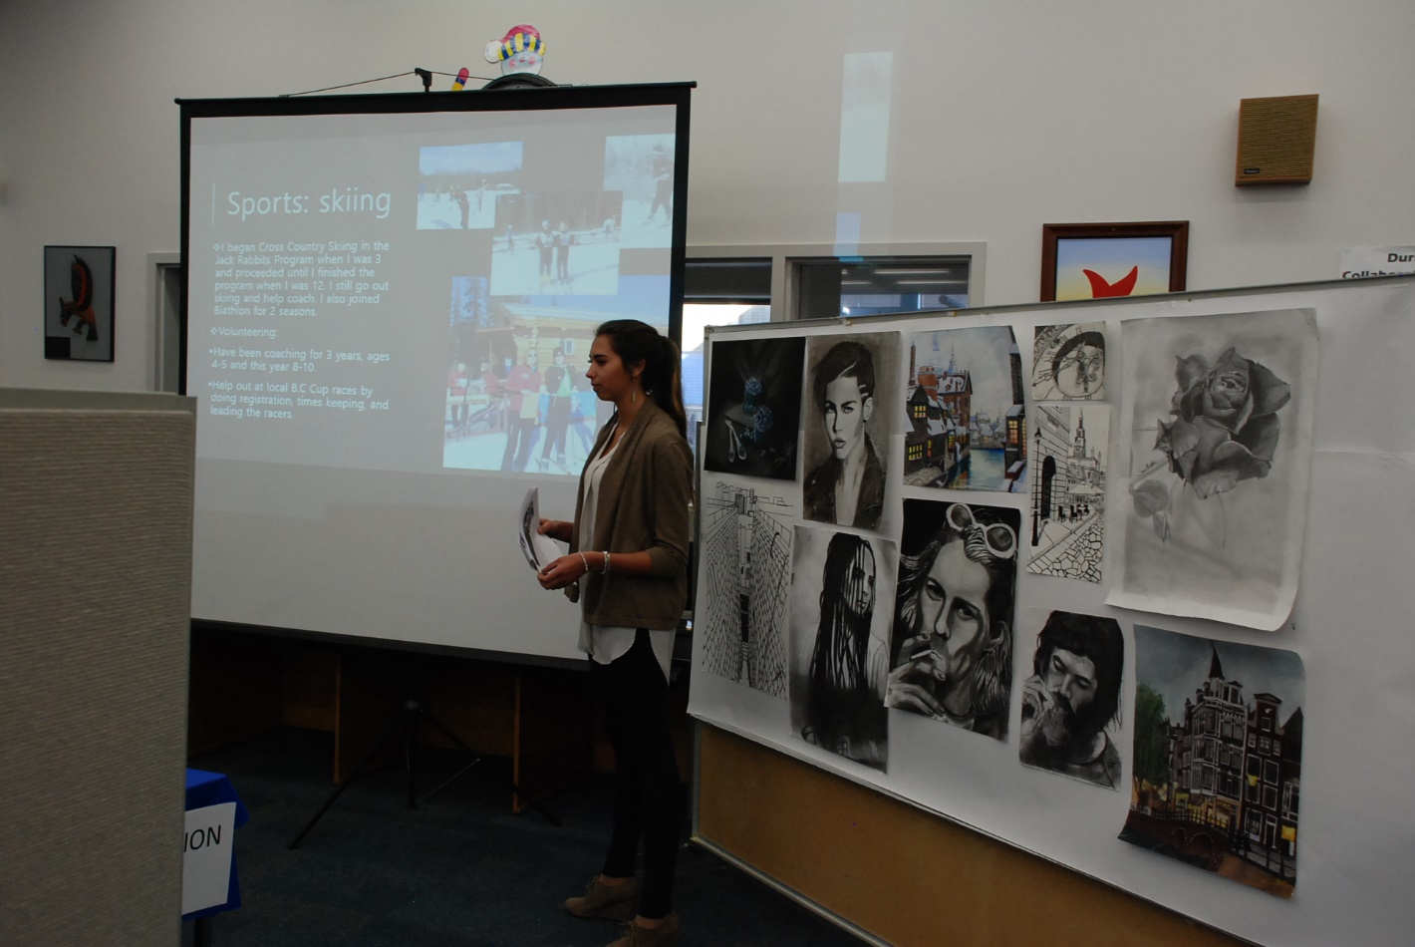

Slide 28
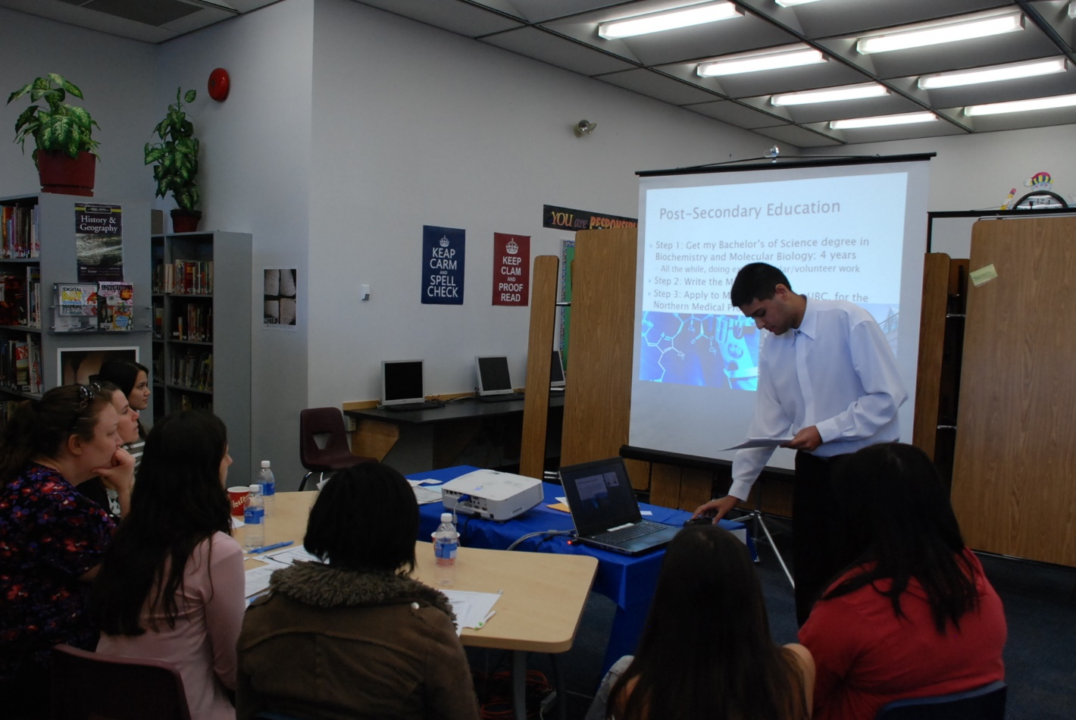
Talk about your Future Plans

Slide 29
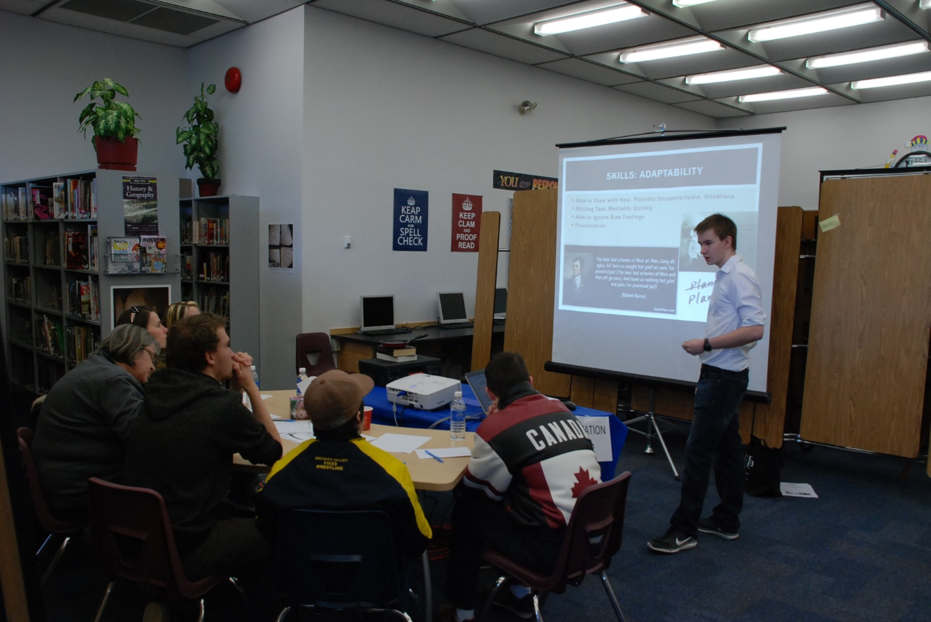
Talk about your Skills and how they will help you in the future.

Slide 30
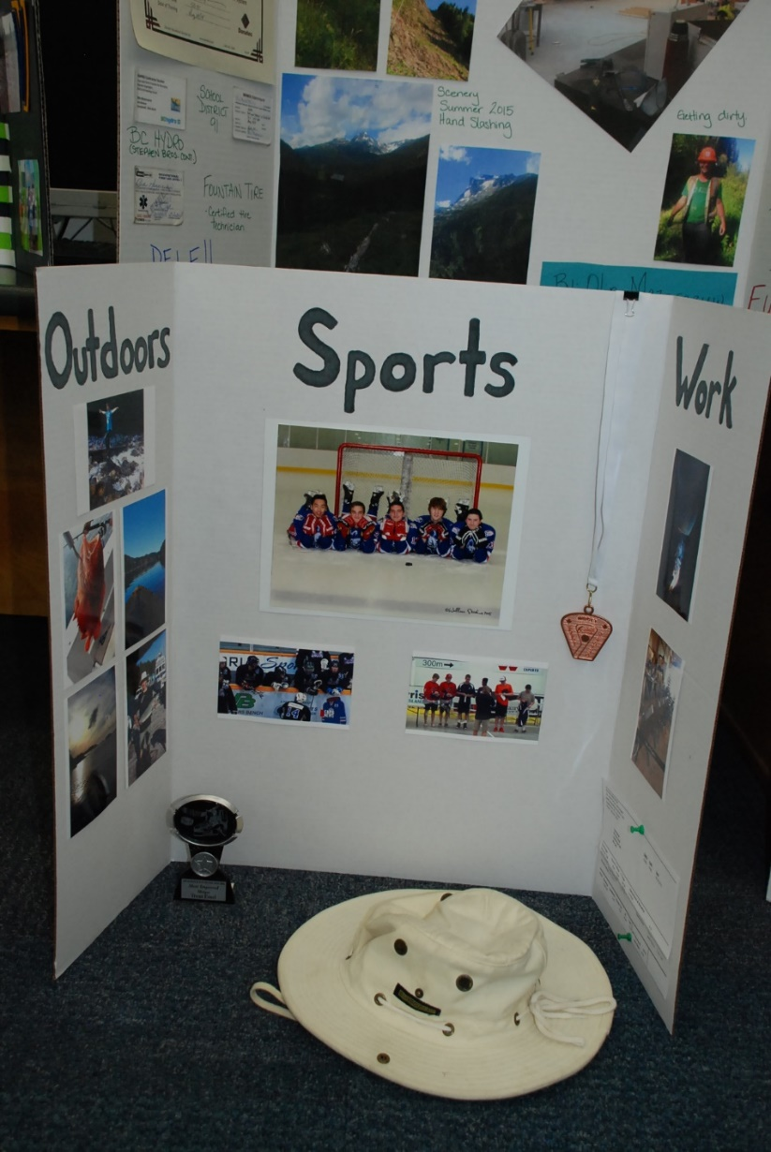
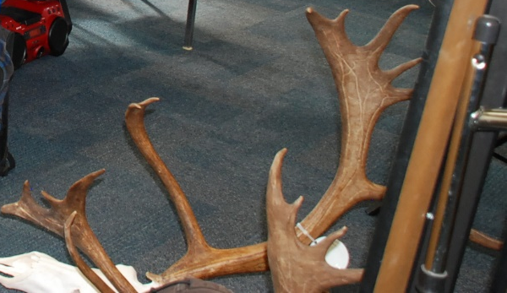
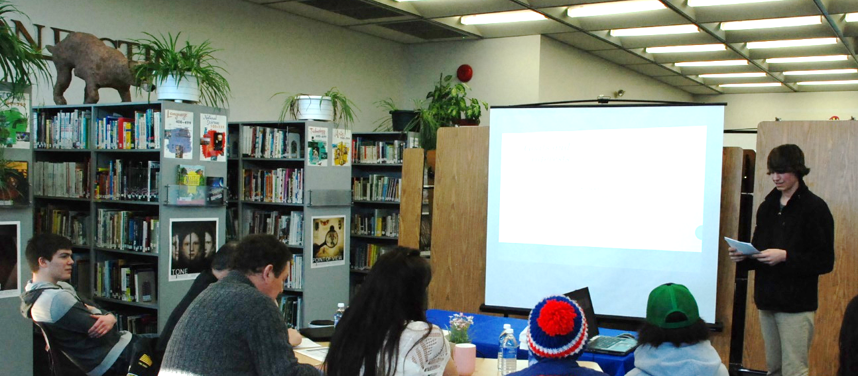
What are your Goals?
How will you reach them?

Slide 31
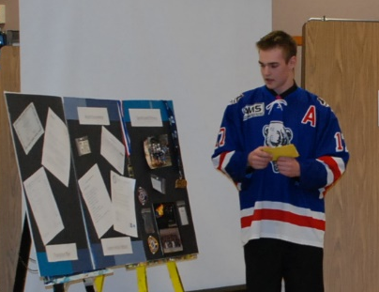
Use CUE CARDS

Slide 32
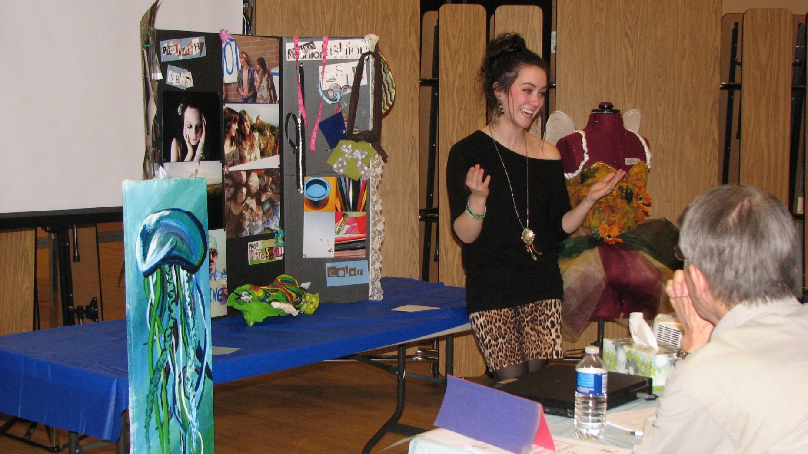
Don’t be afraid to be YOURSELF!

Slide 33
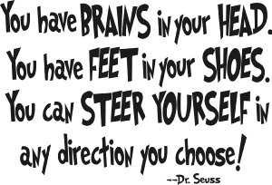
Graduating Class of 2024…

